Slide 1
Web Services

Slide 3

Agenda
01

Slide 4
Agenda
01
Overview

Slide 5
Agenda
01
02
Overview

Slide 6
Agenda
01
02
Data Engineering Services
Overview

Slide 7
Agenda
01
02
03
Data Engineering Services
Overview

Slide 8
Agenda
01
02
03
Data Engineering Services
Overview
AWS
Case Study

Slide 9
Introduction
Amazon Web Services (AWS) is a comprehensive, evolving cloud computing platform provided by Amazon. It offers a wide range of services for computing power, storage, databases, machine learning, analytics, content delivery, and more.

Slide 10
Key Advantages of AWS
AWS provides the ability to scale resources up or down based on demand, ensuring optimal performance and cost efficiency
Scalability
AWS offers a highly reliable infrastructure with multiple data centers across the globe, reducing the risk of downtime
Reliability and High Availability
AWS employs a robust set of security measures and compliance protocols to protect data and applications
Security
AWS offers a pay-as-you-go pricing model, allowing businesses to pay only for the resources they use
Cost-Effectiveness

Slide 11





AWS Data Engineering Layers
Amazon Kinesis
COLLECTION
AWS IoT Core
AWS Direct Connect
STORAGE
AWS DMS
PROCESSING
AWS SQS

Slide 12



AWS Data Engineering Layers
COLLECTION
S3 + Glacier
STORAGE
DynamoDB
PROCESSING
ANALYSIS
ElastiCache

Slide 13






AWS Data Engineering Layers
COLLECTION
STORAGE
AWS Lambda
PROCESSING
AWS Glue
Amazon EMR
ANALYSIS
Amazon ML
VISUALIZATION
Amazon SageMaker
AWS Data Pipeline

Slide 14



AWS Data Engineering Layers
STORAGE
PROCESSING
OpenSearch
ANALYSIS
Amazon Athena
VISUALIZATION
SECURITY
Amazon Redshift

Slide 15

AWS Data Engineering Layers
PROCESSING
ANALYSIS
VISUALIZATION
Amazon QuickSight
SECURITY

Slide 16


AWS Data Engineering Layers
VISUALIZATION
Amazon KMS
SECURITY
AWS CloudHSM

Slide 17
AWS Case Study
NYC Taxi & Limousine Commission (TCL)

Slide 18
Project Overview
The project working on data of the Taxi Network in New York City. Getting the data from a “Real-Time” source, collecting it into our queueing service, and then processing it to build dashboards will help the business gain insights about how everything is working in the network itself and the customers' behavior over time, in real-time and daily aggregated.

Slide 19




Project Pipeline
DynamoDB
Check Point
Amazon Athena
Power BI
Real-Time Dashboard
S3 Source File
Taxi Application using Lambda
Producer
For Streaming
Kinesis
Streaming
Consumer
For Streaming
DynamoDB
Staging Area
Container and Orchestration
QuickSight Analytical Dashboard
Update Redshift Data Warehouse
S3 Daily Data
Staging Area
AWS Event Bridge
AWS Step Function

Slide 20

Taxi Application
Simulate the data streaming

Slide 21
Taxi Application
Simulate the data streaming
Generate a random range of records

Slide 22
Taxi Application
Simulate the data streaming
Generate a random range of records
Write each new batch on S3 b bucket

Slide 23
Taxi Application
Simulate the data streaming
Generate a random range of records
Write each new batch on S3 b bucket
Write all batches on Check Point DynamoDB Tables

Slide 24

Lambda Streaming Producer
Triggered by the Taxi Application

Slide 25
Lambda Streaming Producer
Triggered by the Taxi Application
Transfer the batch when it comes to the S3 bucket to Kinesis Stream.

Slide 26
Lambda Streaming Producer
Triggered by the Taxi Application
Transfer the batch when it comes to the S3 bucket to Kinesis Stream.
The Parquet file is retrieved from S3 and then read into a Pandas DataFrame.

Slide 27
Lambda Streaming Producer
Triggered by the Taxi Application
Transfer the batch when it comes to the S3 bucket to Kinesis Stream.
The Parquet file is retrieved from S3 and then read into a Pandas DataFrame.
Each record in the DataFrame is sent to the Kinesis Data Stream using a loop.

Slide 28
Lambda Streaming Consumer
Receive data from Kinesis Data Stream

Slide 29
Lambda Streaming Consumer
Receive data from Kinesis Data Stream
Decodes the data and parses it as JSON

Slide 30
Lambda Streaming Consumer
Receive data from Kinesis Data Stream
Decodes the data and parses it as JSON
The JSON data is converted to a Pandas DataFrame

Slide 31
Lambda Streaming Consumer
Receive data from Kinesis Data Stream
Decodes the data and parses it as JSON
The JSON data is converted to a Pandas DataFrame
Apply some transformation to data, and then store it into DynamoDB tables

Slide 32

DynamoDB Tables
Used as a No-SQL staging area

Slide 33
DynamoDB Tables
Used as a No-SQL staging area
Store the processed data that will be sent to a real-time dashboard

Slide 34
DynamoDB Tables
Used as a No-SQL staging area
Store the processed data that will be sent to a real-time dashboard
The data will be sent to Redshift to build a Data Warehouse schema

Slide 35

Analytical Dashboard
Quicksight dashboard that is updated daily

Slide 36

AWS RedShift
AWS Redshift is a data warehouse for storing and analyzing taxi-related data

Slide 37
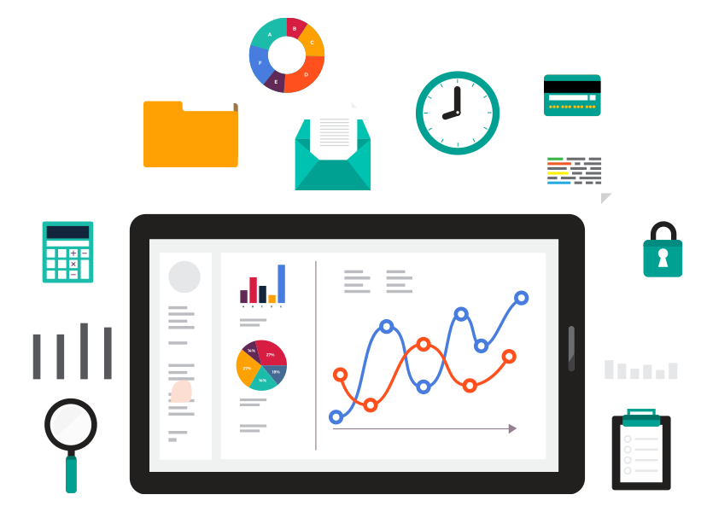
Real-Time Dashboard
Athena

Slide 38
Real-Time Dashboard
Athena
Power BI

Slide 39
Real-Time Dashboard
Athena
Power BI
Automated Refresh

Slide 40
Thank You!
Any Questions?

